Slide 1
Digital Portfolio
STUDENT NAME: VISHNU PRIYA C
REGISTER NO AND NMID: 2428B0365
DEPARTMENT: BSc COMPUTER SCIENCE WITH DATA ANALYTICS
COLLEGE: KPR COLLEGE OF ARTS, SCIENCE AND RESEARCH/BHARATHIAR UNIVERSITY

Slide 2
PROJECT TITLE
Front-End Developer | Internship & Industrial Exposure

Slide 3


AGENDA
Problem Statement
Project Overview
End Users
Tools and Technologies
Portfolio design and Layout
Features and Functionality
Results and Screenshots
Conclusion
Github Link
3/21/2024 Annual Review

Slide 4

PROBLEM STATEMENT
n today’s digital world, professionals need an interactive and visually appealing online presence to showcase their skills and projects. Many students struggle to present their internships and personal projects effectively, which can limit opportunities in front-end development.
This project aims to create a colorful, responsive digital portfolio for Vishnu Priya C to highlight her skills, projects, and internships, ensuring clear presentation and easy navigation.

Slide 5

PROJECT OVERVIEW
The project is a creative, colorful, and responsive digital portfolio for Vishnu Priya C, a Front-End Developer. It showcases her skills, projects, internships, and industrial exposure in an organized and visually appealing way. The portfolio includes interactive project cards, a contact section, and a functional download resume button, providing an effective platform for presenting her professional capabilities to potential employers and collaborators.

Slide 6

WHO ARE THE END USERS?
The primary end users of this digital portfolio are potential employers and recruiters who want to evaluate Vishnu Priya C’s skills, projects, and industrial experience. Additionally, clients or collaborators seeking a Front-End Developer can use the portfolio to assess her capabilities. Academic mentors and peers may also refer to it to review her internship and project work. Overall, the portfolio serves as a professional platform for personal branding, helping Vishnu Priya C showcase her expertise and achievements effectively.

Slide 7

TOOLS AND TECHNIQUES
This digital portfolio is developed using HTML, CSS, and JavaScript, which form the core technologies for front-end development. Responsive design techniques are applied to ensure compatibility across devices, while CSS animations and hover effects enhance visual appeal. The project also uses interactive project cards, smooth scrolling, and a functional download resume button to improve user experience. Tools like Visual Studio Code are used for development, and Google Fonts and placeholder images help create a modern, colorful design.

Slide 8
POTFOLIO DESIGN AND LAYOUT
The portfolio features a modern, colorful, and responsive design to create a visually engaging experience. It uses a card-based layout to display projects and internships, making information easy to navigate. The header section highlights the name and profession, while a navigation menu allows smooth scrolling to different sections such as Skills, Projects, Experience, and Contact.
8

Slide 9
FEATURES AND FUNCTIONALITY
The digital portfolio includes several key features to enhance user experience and presentation. It showcases projects, internships, and industrial exposure using interactive cards, making information easy to access and visually appealing. A download resume button allows users to obtain Vishnu Priya C’s resume directly. The portfolio also has smooth scrolling navigation, ensuring seamless movement between sections, and is fully responsive, providing a consistent experience across desktops, tablets, and mobile devices.

Slide 10
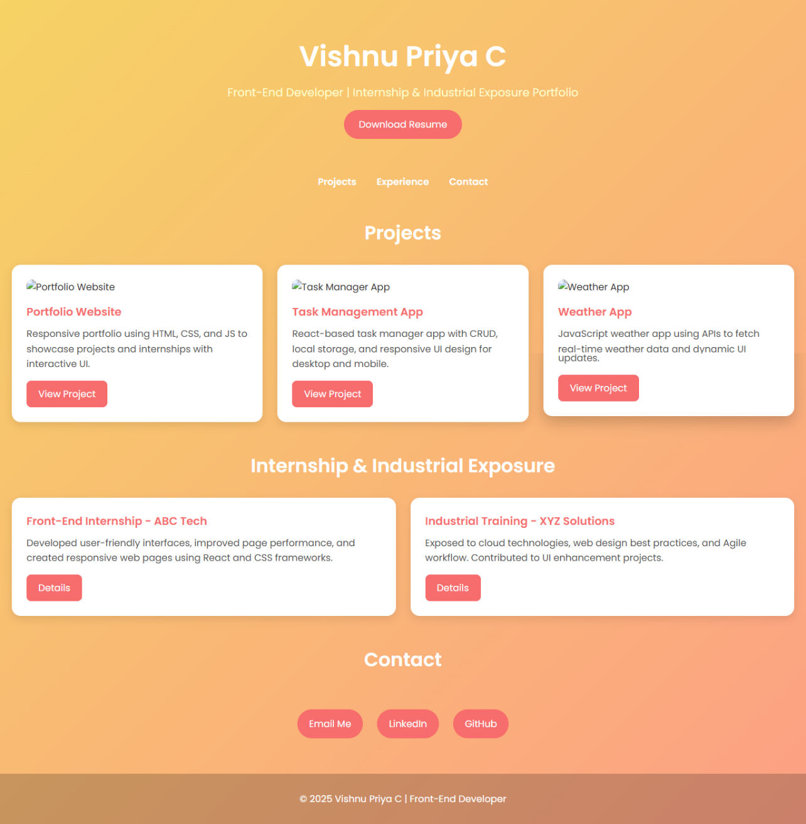

RESULTS AND SCREENSHOTS
3/21/2024 Annual Review
10

Slide 11
CONCLUSION
This digital portfolio effectively presents Vishnu Priya C’s skills, projects, internships, and industrial exposure in a professional and visually engaging manner. It provides a responsive, interactive, and user-friendly platform that enhances personal branding and helps potential employers, clients, and collaborators easily evaluate her capabilities.
11

Slide 12
GITHUB LINK
https://vishnupriya-2403.github.io/Naan-Muthalvan/
12

